Slide 1

DriverPass
System Analysis
Polo Navarro
Notes:
This presentation gives a quick overview of the DriverPass system I designed. I’ll walk through the main requirements, the use case diagram, an activity diagram, and how the system handles security and limitations. Everything is explained in simple terms so you can see how the system supports your business goals.

Slide 2

System Requirements
Functional Requirements:
Students can schedule lessons.
Students can take practice tests.
Nonfunctional Requirements
System must be secure and protect user data.
System must be available online and easy to use.
Notes:
The requirements describe what the system needs to do and how it should perform. Scheduling lessons and taking practice tests are the core features students rely on. On the nonfunctional side, the system needs to be secure, reliable, and easy for anyone to use. These requirements guided the design decisions throughout the project.

Slide 3
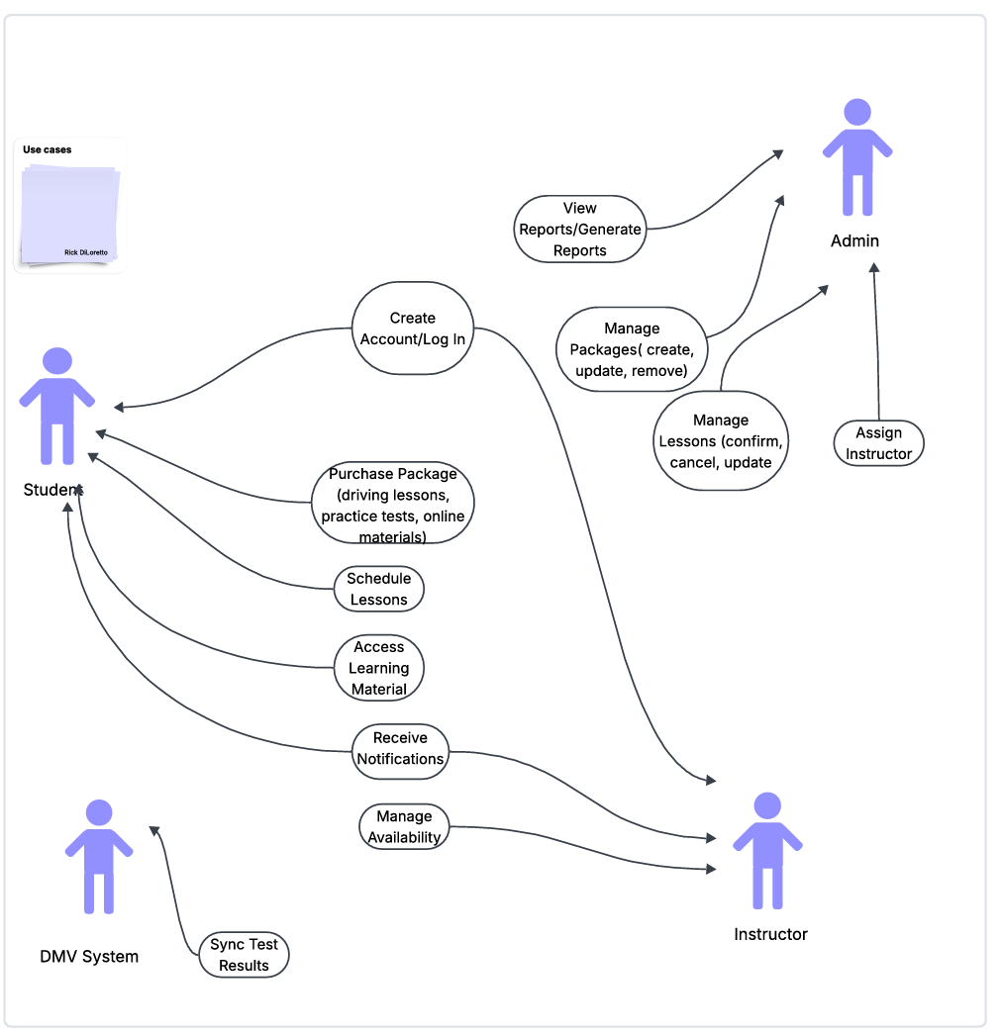
Use Case Diagram
Notes:
The diagram shows the main interactions between users and the DriverPass system. Students can purchase packages, schedule lessons, and take practice tests. Instructors manage their availability and teach lessons. Admins oversees instructors, vehicles, and packages. The DMV system is included because test results need to sync. This diagram helps visualize how each part of the system supports the business workflow.

Slide 4
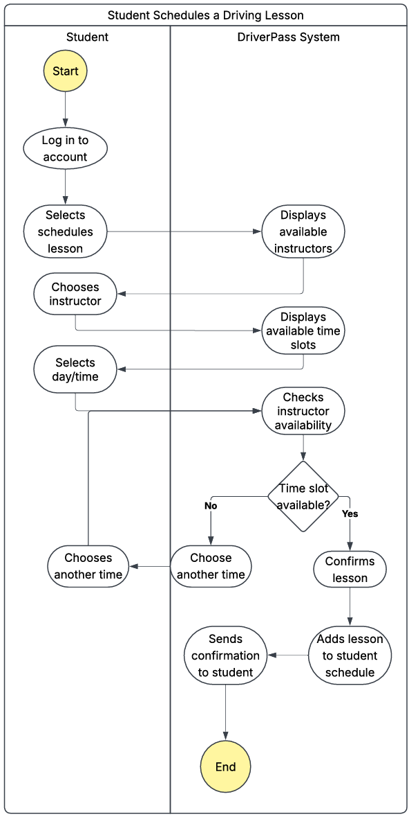
Activity
Diagram
Notes:
This activity diagram breaks down one process step-by-step. For example, scheduling a lesson starts when the student logs in, check available times, selects a slot, and confirms the booking. The system updates the instructor’s schedule and sends a notification. This helps show how the system handles tasks behind the scenes in a simple, organized flow.

Slide 5
Security
Encrypted communication (HTTPS)
Secure login and password protection
Role-based access (student, instructor, admin)
Regular backups and data protection
Notes:
Security is built into the system from the start. All communication is encrypted, and user accounts are protected with secure login methods. Each role only sees what they need to see, which keeps sensitive information safe. The system also uses backups and monitoring to protect data and keep everything running smoothly.

Slide 6
System Limitations
Requires internet access
Depends on cloud hosting uptime
Users need basic computer or mobile skills
DMV integration depends on external systems
Notes:
Like any system, DriverPass has limitations. It requires internet access, and it depends on cloud hosting to stay online. Users need basic computer or mobile skills to navigate the system. Also, syncing test results relies on the DMV system, so any delays or downtime on their side can affect updated.

